Slide 1
DESIGN AND IMPLEMENTATION OF A COMMUNICATION SOTFWARE AS A SERVICE ( A case study of oyscatech). PRESENTED BY: ADEWALE AYOMIDE CHRISOPHER MATRIC NUMBER: HND/210453 OYEWUSI CECILIA OMOLOLA MATRIC NUMBER: HND/211316 SUPERVISED BY: MR. ABIMBOLA

Slide 2
INTRODUCTION
In today's rapidly evolving educational landscape, the effective management of information and communication is paramount for the smooth functioning of educational institutions. The modern institution environment demands efficient communication systems that bridge the gap between school management, teaching staff, and students. This chapter introduces the research topic, design and implementation of communication software as a service which aims to address the pressing need for an integrated communication system within educational institutions.

Slide 3
STATEMENT OF THE PROBLEM
The central problem addressed in this research project is the absence of an efficient and effective information and communication system that connects school management, teaching staff, and students. Current communication methods often lead to:
Delays in the dissemination of critical information.
Incomplete communication channels, leaving some stakeholders uninformed.
Difficulty in accessing important resources and updates.
This problem creates inefficiencies and can impact the overall quality of education and administrative processes within educational institutions.

Slide 4
AIM AND OBJECTIVES
AIM
The aim of this project is to create seamless, efficient , and cost-saving communication system software for the communication and dissemination of information in Oyscatech.
OBJECTIVES
The primary objectives of this research project are as follows:
To design a comprehensive information and communication system that facilitates seamless communication between school management, teaching staff, and students.
To implement the designed system within a real educational institution to assess its practicality and effectiveness.
To evaluate the impact of the implemented system on communication efficiency, administrative processes, and student engagement.
To provide recommendations for the wider adoption of similar systems in educational institutions.

Slide 5
JUSTIFICATIONS
Efficient Communication: Traditional communication methods in educational institutions often result in delays and limited reach, creating communication gaps. This project aims to bridge these gaps by implementing an integrated system for timely and accurate information dissemination.
Administrative Efficiency: Streamlining administrative processes is crucial for cost savings and optimizing resources. The proposed system will digitize record-keeping, automate tasks, and enhance overall administrative efficiency.
Enhanced Student Engagement: Easy access to resources and updates will boost student engagement, leading to improved performance, higher satisfaction, and reduced attrition rates.
Potential for Wider Adoption: Success here can serve as a model for other institutions, providing insights and recommendations for broader adoption in the education sector.

Slide 6
METHODOLOGY
The research methodology for this project involve a combination of qualitative and quantitative approaches.
DATA COLLECTION AND TECHNIQUES.
Data is gathered through interviews, and system usage statistics.
The implementation of the system will follow standard software development methodologies, and its impact will be assessed through pre- and post-implementation evaluations such as:
Needs Assessment: Conduct surveys, interviews, and workshops to assess the communication needs and challenges within the school.
System Design: Based on the needs assessment, design an integrated Information and Communication System, considering the specific requirements of school management, staff, and students.
System Implementation: Develop and implement the system using appropriate technologies and platforms.
System Testing and Evaluation: Assess the system's functionality, usability, and effectiveness through user testing and feedback.

Slide 7
METHODOLOGY
SYSTEM DESIGN MODEL
SOURCE
INFORMATION
DESTINATON
INFORMATION SHARED
INFORMATION FINALIZED
FINFORMATION DISCUSSED

Slide 8
SYSTEM FLOW CHART

Slide 9
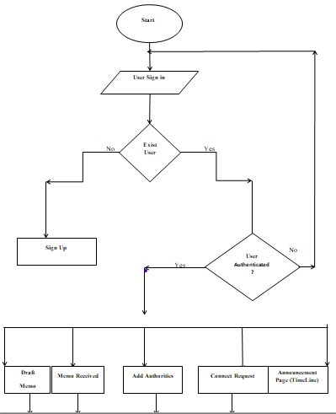

Slide 10
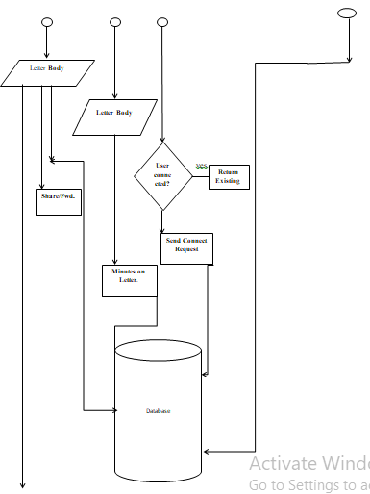

Slide 11
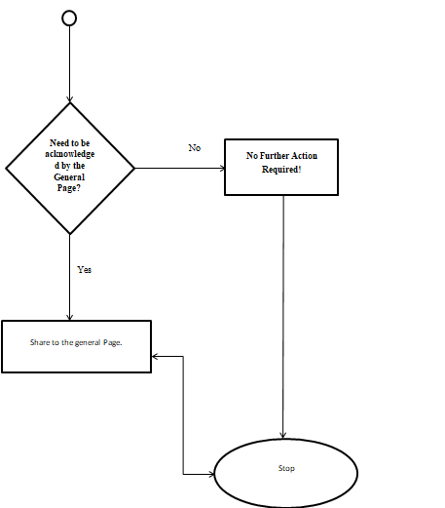

Slide 12
USED CASE DIAGRAM

Slide 13
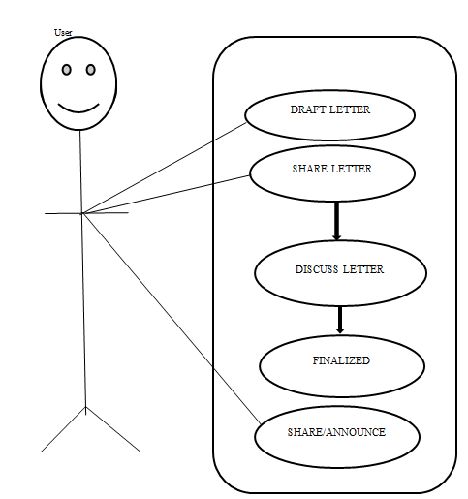

Slide 14
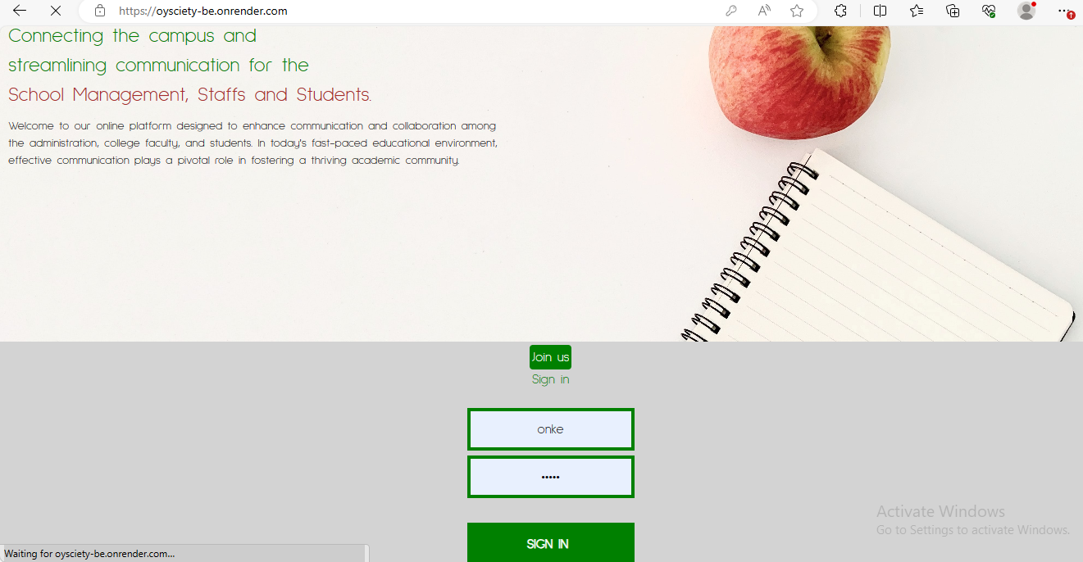
RESULT EVALUATION
SIGN IN PAGE

Slide 15
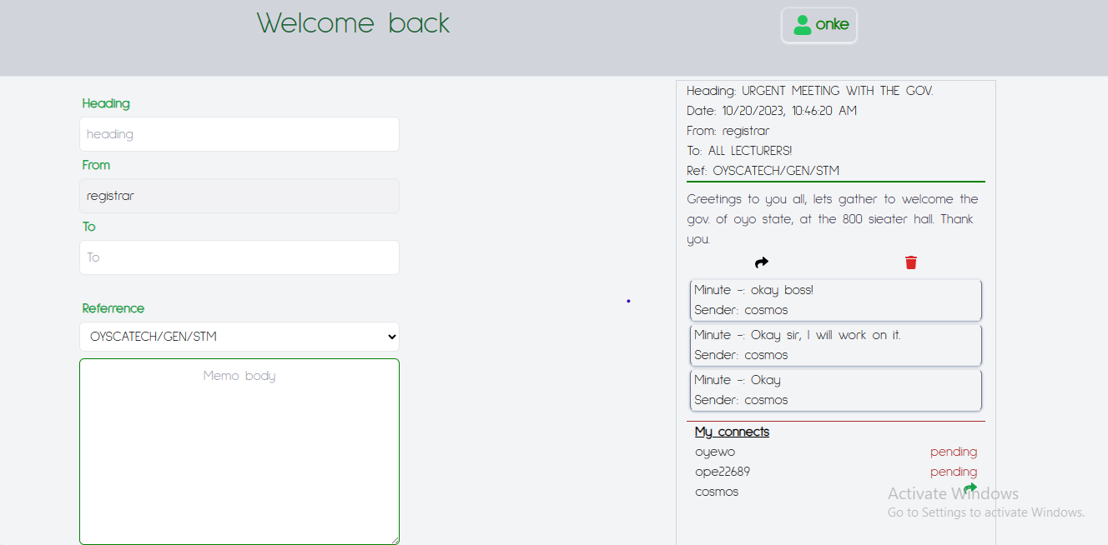
RESULT EVALUATION

Slide 16
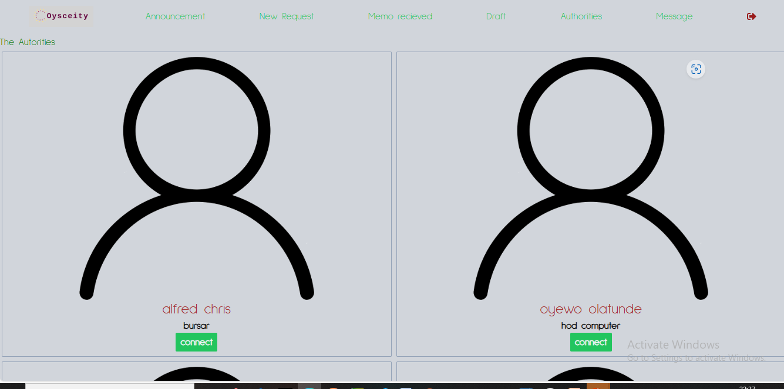
RESULT EVALUATTION
Add authorities.

Slide 17

RESULT EVALUATION
Accept Connect Request

Slide 18
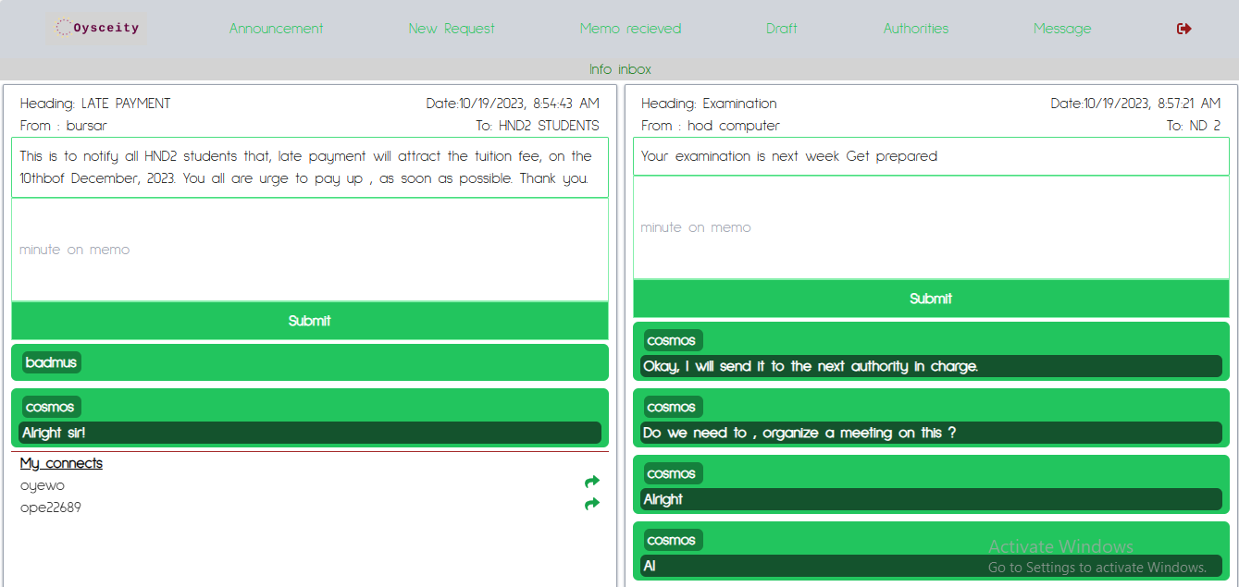
RESULT EVALUATION
RECEIVED LETTER

Slide 19
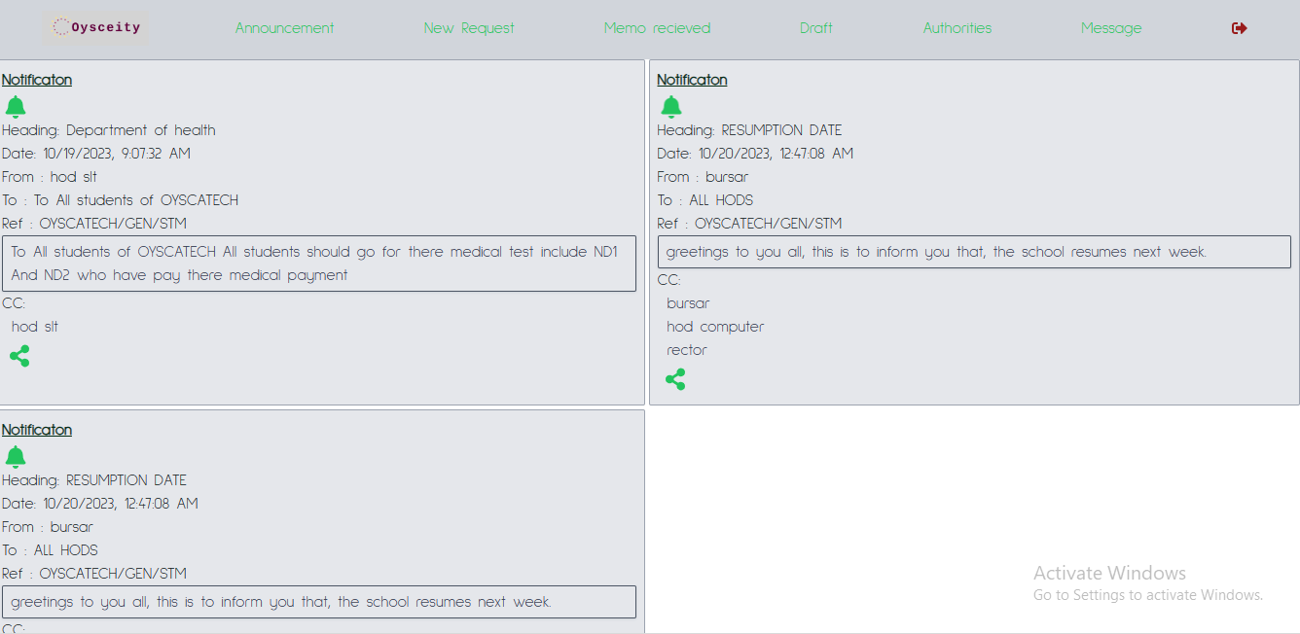
RESULT EVALUATTION
Announcement Page

Slide 20
SUMMARY
Synthesizing key findings, the project's denouement encapsulated an introspective reflection on the challenges encountered, invaluable insights garnered, and pertinent lessons assimilated throughout the project's lifecycle. Furthermore, it expounded upon the pivotal role of this endeavor in propelling the domain of SaaS development, whilst delineating potential avenues for future enhancements and expansions of the SaaS application.
Furthermore, the project focuses on the conceptualization, development, and deployment of a SaaS platform. It delves into the essential components and methodologies involved in creating a software solution delivered over the internet as a service. And the primary aim of this project is to design, develop, and deploy a SaaS application that offers seamless, secured and efficient informatics and communication system.

Slide 21
REFERRENCE
Al-Ali, A. R., & Ahmed, F. (2016). An Integrated Cloud-Based System for Educational Institutions. Procedia Computer Science, 82, 291-296.
Gupta, R., & Sharma, S. (2019). Modernizing Education: A Case Study of ICT Integration in a School in India. Computers in Human Behavior, 91, 303-308.
Koswatta, R., Gamage, D. T., & Rathnayaka, A. (2019). Design and Implementation of a Communication System for Schools. *International Journal of Emerging Technologies in Learning, 14(12), 147-160.
UNESCO. (2013). Communication and Information in Education: A Toolkit for Teachers, Educators, and School Leaders. Retrieved from https://unesdoc.unesco.org/ark:/48223/pf0000219369
Zhao, Y., Lei, J., Yan, B., Lai, C., & Tan, Q. (2005). What Makes the Difference? A Practical Analysis of Research on the Effectiveness of Distance Education. Teachers College Record, 107(8), 1836-1884

